Slide 1
Statistical and Predictive Modeling Final Project (DATA 1204) Name of the Student: Maisha Khatoon Student ID: 100899259

Slide 2
Research Requirements
Background: Mr. John Hughes has devoted his efforts to comprehending the impact of several industry characteristics on scaled stock returns. To facilitate this undertaking, he has collected a dataset consisting of 180 observations and 7 distinct characteristics.
Characteristics:
Explanatory (Input) variables:
Return: Refers to the financial gains or losses obtained from investing in stocks.
market_overview: Represents the prevailing market sentiment or outlook, which is classified as either neutral, positive, or negative.
Dividend: Indicates if the stock offers a dividend payment (1 for affirmative, 0 for negative).
earnings_ranking: A ranking that is determined by the performance of earnings.
The debt-to-equity ratio is a metric that quantifies a company's financial leverage.
Market cap refers to the total value of a company's outstanding shares of stock. It is calculated by multiplying the current market price per share by the total number of shares outstanding.
Dependent variable:
stock_return_scaled: This variable represents the adjusted returns of the stock, which have been scaled.
Mr. Hughes' Inquiry:
Mr. Hughes is seeking answers to the following questions to acquire insights into his research:
a) Impact of Dividend: Examine the influence of dividend payments on scaled stock returns using a linear regression model.
b) Impact of Multiple Variables: Create a multivariate regression model to analyze the cumulative influence of all input variables on scaled stock returns.
This slide provides an overview of Mr. Hughes' research experience, the dataset’s characteristics, and his specific research questions. Enhance the slide's appeal by including pertinent graphics or iconography.

Slide 3
Basic Statistics
Data Statistics Overview: Let us examine the descriptive statistics of our dataset to comprehend the central patterns and variability of each attribute.
Mean Values:
Return: 2617
Market Overview: N/A (Categorical Data)
Dividend: 0.5333
Earnings ranking: 23.91
Debt-to-equity ratio: 1.0408
Market capitalization: 1540
Scaled stock return: 194.17
Main Findings:
Return: The average return is 2617, which indicates the average profitability of stock investments.
Dividend: The majority of stocks, specifically 53.33% of them, distribute dividends. On average, these dividends yield roughly 0.5333.
earnings_ranking: The mean earnings ranking is approximately 23.91, suggesting a modest level of success across the dataset.
The debt-to-equity ratio of corporations, on average, is 1.0408, indicating a well-balanced financial structure.
Market capitalization: The mean market capitalization is 1540, which represents the average size or worth of the enterprises included in our dataset.
stock_return_scaled: The mean standardized stock return is 194.17, representing a normalized measure of stock performance.

Slide 4
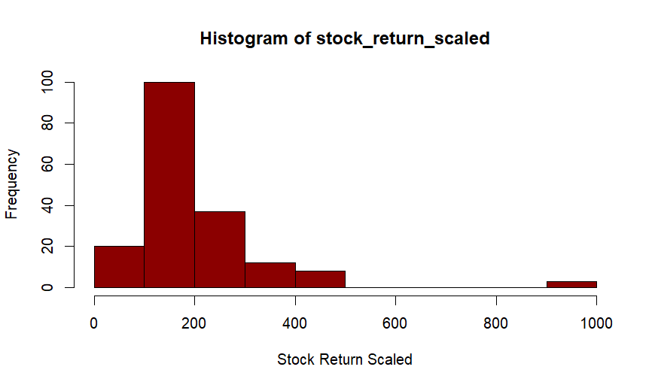
Histogram of stock_return_scaled
Distribution: Skewed right
Range: 30.38 to 984.54

Slide 5
Key findings: Histogram of stock_return_scaled
The histogram displays a skewed right distribution, indicating that the majority of scaled stock returns are clustered towards the lower end, with a small number of outliers towards the upper end.
Frequency Peaks: The bulk of stock returns are concentrated within the range of 125 to 211, suggesting a prevalent range of returns.
Explanation:
The presence of a skewed distribution implies that the majority of stocks exhibit moderate returns, while a smaller number of companies demonstrate extraordinarily high returns, suggesting the possibility of outliers or stocks that perform exceptionally well.
This slide presents a histogram that visually represents the distribution of the stock_return_scaled variable. It offers valuable insights into the form and range of the variable.

Slide 6
T-test Assumptions and Hypotheses:
Evaluating the mean value of the scaled stock returns:
A one-sample t-test is being done to determine if the mean of stock_return_scaled substantially deviates from 300.
Proposed hypotheses for a t-test:
The null hypothesis (h0) states that the mean of the scaled stock returns is equal to 300.
Alternative hypothesis (h1): the mean of stock_return_scaled is not equal to 300.
Prerequisites for t-test:
Data distribution: assumes that the data follows a normal distribution.
Independence: assumes that each observation is uncorrelated with the others.
Random sampling: assumes that the data is obtained from a sample that is selected randomly.
Main discoveries:
The t-value is -10.511,
The degree of freedom (df) is 179,
p-value is less than 2.2e-16.
Analysis and explanation of findings:
Due to the significantly small p-value (< 0.05), we can confidently reject the null hypothesis. This provides compelling evidence contradicting the assertion that the average scaled stock return is equal to 300.

Slide 7
T-test Results
Primary Explanations:
T-value Explanation: A larger absolute T-value shows more evidence against the null hypothesis.
The term "p-value" refers to the probability of obtaining a test statistic as extreme as, or more extreme than, the observed value, assuming that the null Importance: The p-value is significantly small (< 0.05), suggesting that our conclusion holds statistical significance.
Conclusion: There is compelling evidence that contradicts the null hypothesis.
The average scaled stock return is notably distinct from 300.
T-test findings:
The T-value is -10.511 and the degrees of freedom (df) are 179.
p-value: less than 2.2e-16

Slide 8
Simple Linear Regression Results
Analyzing the influence of dividends on scaled stock returns:
A simple linear regression was conducted to examine the correlation between dividend and stock_return_scaled.
Simple Linear Regression Model:
stock_return_scaled = (β₀ +β₁)* dividend
Where:
Intercept (β₀) : 196.903
The coefficient for Dividend (β₁): -5.118
Key Interpretations:
Intercept:
The intercept denotes the expected value of stock_return_scaled when the dividend is equal to 0.
The estimated intercept is 196.903.
Dividend Coefficient:
A dividend is a sum of money that is paid regularly to shareholders of a company as a share of the company's profits.
Coefficient: For every one-unit increase in the dividend, the stock_return_scaled drops by about 5.118 units.
Coefficient Significance: The p-value is 0.801, indicating that the result is not statistically significant.
Model Fit:
The coefficient of determination (R-squared/ R²) for the model is 0.0003594.
The dividend accounts for a mere 0.036% of the variability in the scaled stock return.

Slide 9
Multiple Linear Regression Model
Analyzing the Impact of Combined Factors on Adjusted Stock Returns:
Multiple linear regression was performed to measure the collective influence of all input factors on stock_return_scaled.
Multiple Linear Regression Model:
stock_return_scaled= β₀ +β₁* return+β₂*market_overviewneutral+β₃*market_overviewpositive+β₄*dividend+β₅*earnings_ranking+β₆*debt_to_equity + β₇* marketcap
Coefficients and Interpretations:
Intercept (β₀): The value of β₀ is 12.63174. The anticipated scaled stock return is when all predictors have a value of zero.
Return (β₁): The returned value is 0.12446. An incremental rise in return corresponds to a 0.12446 increase in stock_return_scaled. The p-value of 0.070 indicates marginal significance.
market_overviewnetural (β₂): 156.93738. Remaining impartial in market_overview is correlated with a 156.93738 rise in stock_return_scaled. The p-value is less than 0.001, indicating statistical significance. The market overview shows a positive trend with a beta coefficient of 105.98573.
market_overviewpositive (β₃): A favorable attitude in market_overview is correlated with a 105.98573 increase in stock_return_scaled. The p-value is 0.036, indicating statistical significance.
dividend (β₄): The dividend (β₄) is equal to -21.58592. An increase of one unit in dividend results in a loss of 21.58592 in stock_return_scaled. The p-value is 0.479, indicating that the result is not statistically significant.
earnings_ranking (β₅): 4.33123. An incremental rise in earnings_ranking corresponds to a 4.33123 increase in stock_return_scaled. The p-value of 0.553 indicates that the results are not statistically significant.
debt-to-equity ratio (β₆): The debt-to-equity ratio (β₆) is -69.37919. An incremental rise in the debt-to-equity ratio is linked to a reduction of 69.37919 in the scaled stock return. The p-value is 0.001, indicating statistical significance. The market capitalization (β) is 7. The value is -0.16433.
marketcap (β₇): -0.16433. An increase of one unit in market capitalization is correlated with a decrease of 0.16433 in the scaled stock return. The p-value is less than 0.001, indicating statistical significance.
Model Fit:
The coefficient of determination, denoted as R^2, is 0.647.
The predictors account for approximately 64.7% of the variability in stock_return_scaled.

Slide 10
Interpretation of Multiple Linear Regression
Key findings derived from the analysis using multiple linear regression:
Market Analysis Results: Maintaining a neutral stance in the market overview leads to an increase in stock_return_scaled of roughly 156.94 units, whilst a positive market overview results in an increase of around 105.99 units.
The debt-to-equity ratio is a measure of a company's financial leverage. A greater debt-to-equity ratio is linked to a lower stock_return_scaled, with a reduction of 69.38 units for every unit rise in debt-to-equity.
Market capitalization refers to the total value of a company's outstanding shares of stock. It is a measure of the company's size and is calculated by multiplying the current stock price by the number of outstanding shares.
The relationship between market capitalization and stock_return_scaled is inverse, suggesting that larger companies often experience lower returns. For every incremental unit in market capitalization, there is a corresponding reduction of 0.16433 units in stock_return_scaled.
Marginal Significance of Return: The return exhibits a slightly significant positive correlation with stock_return_scaled, indicating that larger returns may result in somewhat higher scaled stock returns.
Inconsequential variables such as dividend, earnings_ranking, and other market_overview categories (which have a negative effect) do not exert a substantial influence on stock_return_scaled.

Slide 11
Implications and Recommendations
Implications and Recommendations:
Market sentiment plays a significant role: When market sentiment is neutral to positive, it has a favorable effect on the scaled returns of stocks. It is imperative for companies to closely observe and adjust to changes in market trends.
Financial well-being: Effective management of debt-to-equity ratios is crucial for companies to retain investor trust and potentially achieve higher profits.
Size does not always guarantee benefits: Although larger organizations may provide stability, they may not necessarily yield the biggest results. For maximum profits, investors should diversify their investments according to criteria such as size and other relevant considerations.
Proposed Areas for Future Research:
Extra variables: Key economic measures: Utilize indicators such as GDP growth, inflation rates, and interest rates to assess the wider economic consequences.
Interaction Effects: Market Sentiment & Company Size: Examine the potential variation in the influence of market sentiment on stock_return_scaled based on the size of the company. Analysis was conducted over a long period.
Temporal Trends: Analyze the progression of these correlations over time through the implementation of a longitudinal research.
Analysis tailored to a certain industry: Variations across sectors: Investigate whether these linkages are consistent across many industry sectors or if sector-specific variables influence them.
Improving Model Accuracy:
Model Refinement: Integrate non-linear relationships or polynomial terms to capture more intricate relationships.
Data Augmentation: Enrich the dataset by incorporating a wider range of diverse or detailed data sources to facilitate a more comprehensive analysis.

Slide 12
Conclusion and Key Takeaways
The extensive investigation of the elements driving scaled stock returns has provided valuable insights into the dynamics of the industry.
Key Factors Identified:
Market sentiment, debt-to-equity ratio, and company size were determined to be important predictors that have an impact on stock_return_scaled.
The model accounted for approximately 64.7% of the variability in stock_return_scaled.
Investment implications: An investor's guide to making educated judgments and optimizing portfolios for greater returns was developed by comprehending these variables.
Areas for Future Research:
Several potential areas for additional investigation and improvement have been identified. To improve the accuracy and depth of the analysis, it is beneficial to explore new variables, evaluate interaction effects, and carry out longitudinal research.
In conclusion, Continuous exploration and understanding of these elements are thought to facilitate the development of more educated investment plans, which can be advantageous for investors, companies, and the industry as a whole. We appreciate the attention and interest given to this research.

Slide 13
Thank you

